Slide 1

Social Media Application
Task - 4

Slide 2


Social Media Application
A social media platform is a digital hub for connecting, sharing, and interacting.
Users create profiles and post user-generated content, including text, images, videos, and links, which others engage with through likes, comments, and shares.
These platforms foster global connections and impact personal relationships, politics, business, and society at large.
▪
LMS Username | Name | Batch
au910020104039 | Sankari B R P | CC_2
au910020104046 | Uvasri S A | CC_2
au910020104307 | Neelakandan T | CC_2

Slide 3
Task 4
Technical Specifications:
HTML
CSS
React Js , Express Js
MySQL
Description:
Select a scalable DBMS like MySQL for efficient data management.
Implement indexing, parameterized queries, and strong authentication measures for optimized and secure database interactions.
Efficiently manage and reuse database connections to reduce overhead.
Use caching mechanisms to alleviate the load on the database, especially for frequently accessed data.
Set up database replication for read-heavy workloads and consider clustering or sharding for scalable data distribution.

Slide 4
Step-Wise Description :
Research and analyze the specific requirements of the social media application.
Identify frequently queried data and implement optimization techniques like indexing for faster retrieval.
Prioritize security by employing parameterized queries to prevent SQL injection attacks.
Implement robust authentication measures to safeguard user data and maintain database integrity.
Implement connection pooling to efficiently manage database connections.
Connection pooling reduces the overhead of opening and closing database connections, enhancing overall performance.
Caching reduces the need to repeatedly query the database for the same information, improving response times.
Set up database replication to duplicate data across multiple servers.

Slide 5
Consider additional strategies like clustering or sharding to distribute the database load and support future growth in the user base.
Task Summary :
In this project, the task is to develop a social media application using HTML, CSS, React.js for the front-end, and MySQL for the back-end. The front-end will involve creating a visually appealing and interactive user interface with React.js components, allowing users to share stories, create posts, leave comments, and engage in direct messaging. On the back-end, a server will be set up, and a MySQL database schema will be designed to store user data, stories, posts, comments, and messages. API endpoints will be implemented for each entity, and proper authentication and authorization mechanisms will be put in place to secure user accounts and control access to features. The application will include real-time updates using React.js and WebSocket technology, ensuring an engaging and dynamic user experience. Thorough testing will be conducted, and the finalized application will be deployed on a hosting service, accompanied by comprehensive documentation outlining the database schema, API endpoints, and usage guidelines.

Slide 6
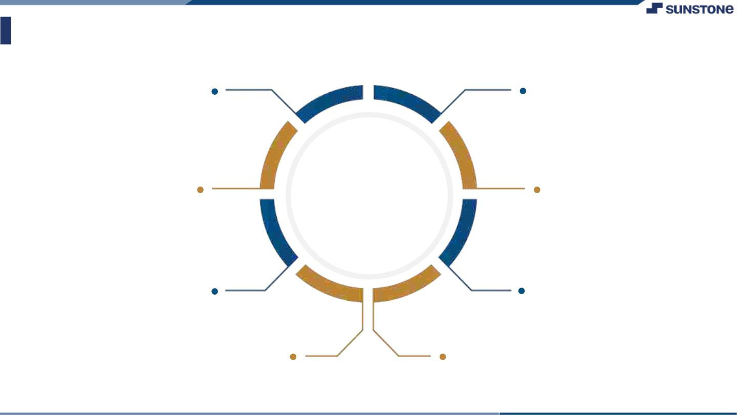
Assessment Parameter
Choose a Database Management System (DBMS) that aligns with scalability and performance requirements.
Conduct thorough testing of database interactions, including unit, integration, and performance tests.
Implement connection pooling to efficiently manage and reuse database connections.
Check-List
Implement monitoring tools to track database performance and establish comprehensive logging for troubleshooting and auditing.
Optimize database queries for efficient data retrieval and manipulation.
Set up database replication for read-heavy workloads and consider clustering or sharding for load distribution across multiple servers.
Use parameterized queries to prevent SQL injection attacks.
Implement caching mechanisms to reduce the load on the database.

Slide 7
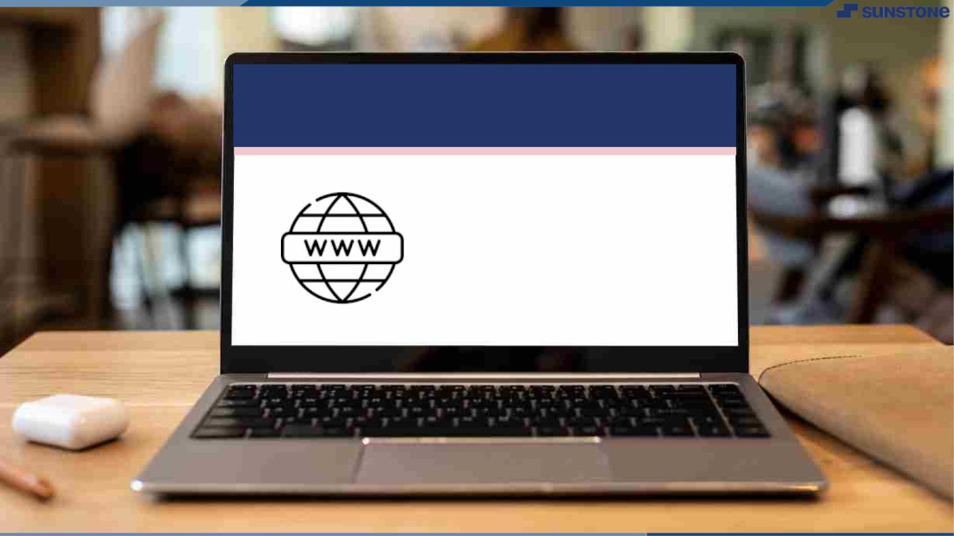
Submission Github
https://github.com/Uvasrisa/Social_media_application

Slide 8


